Slide 1
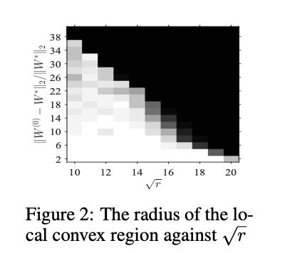
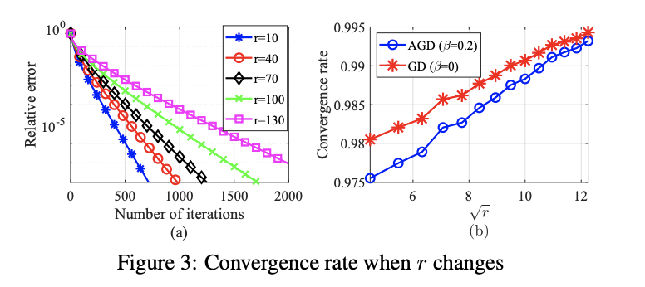
Motivation: LTH has been justified empirically, thus this paper tries to theoretically justify LTH by analyzing performance of training a Sparse NN, in regards to the geometric structure of the objective function and sample complexity to achieve zero generalization error.
Method: They consider a teacher-student setup where for any input x, the corresponding output y is generated by a sparse one-hidden-layer neural network, which is called a teacher. Thus the training data is generated from a teacher network, and they learn on a student network with the same number of neurons as the teacher network. They do not require the student network to have the same architecture as the teacher network. As long as the teacher network can be viewed as a sub-network of the student network by pruning weights, their method finds the ground-truth model with a sufficient number of samples. They use accelerated gradient descent as their learning method and magnitude pruning as their pruning method.
Results: The first result is that within a small vicinity of the ground truth weight matrix, the standard mean squared loss for learning the neural network is convex.
*Moreover, as the algorithm for training a sparse neural network is specified as (accelerated) stochastic gradient descent algorithm, they theoretically show that the number of samples required for achieving zero generalization error is proportional to the number of the non-pruned model weights in the hidden layer.
https://openreview.net/pdf?id=8pz6GXZ3YT

Slide 2
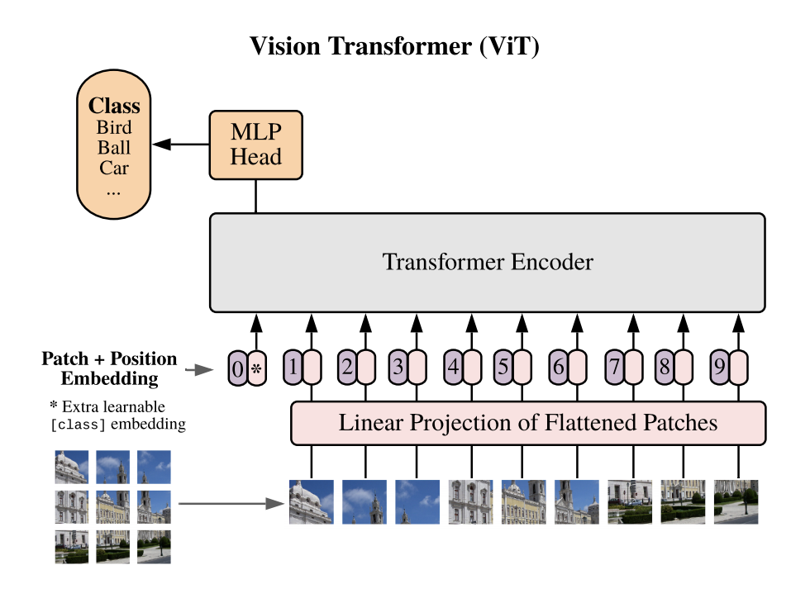
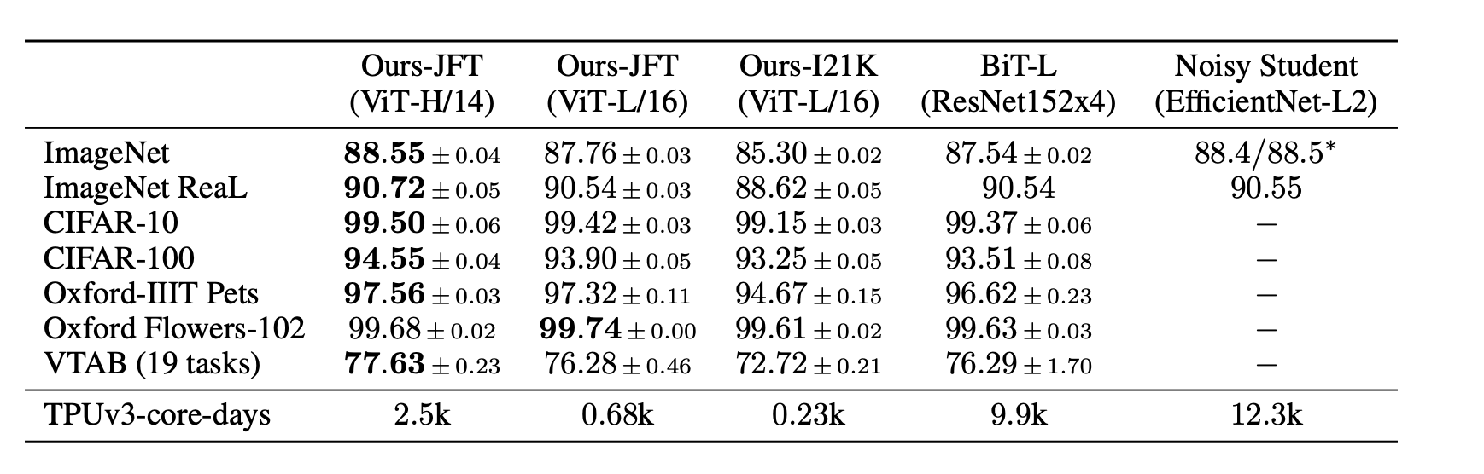
Motivation: The paper showed that we don’t necessarily need CNNs to solve computer vision problems as we thought until now. We can use attention/ self-attention mechanisms from Transformer methods. They achieved SOTA results with less computation thus setting a new standard for image classification.
Method: Separate Input Image into Patches and then flatten patches and apply a linear projection. Then assign a positional embedding to each patch and feed them to original transformer. Finish off by passing vectors from transformer through an MLP to do classification.
Results: If you compare the “HUGE” variant of VIT (transformer model) and compare it to the Resnet and EfficentNet models (CNN models) results you can see it reports better averages in accuracies and less computational resources.
https://arxiv.org/pdf/2010.11929.pdf

Slide 3
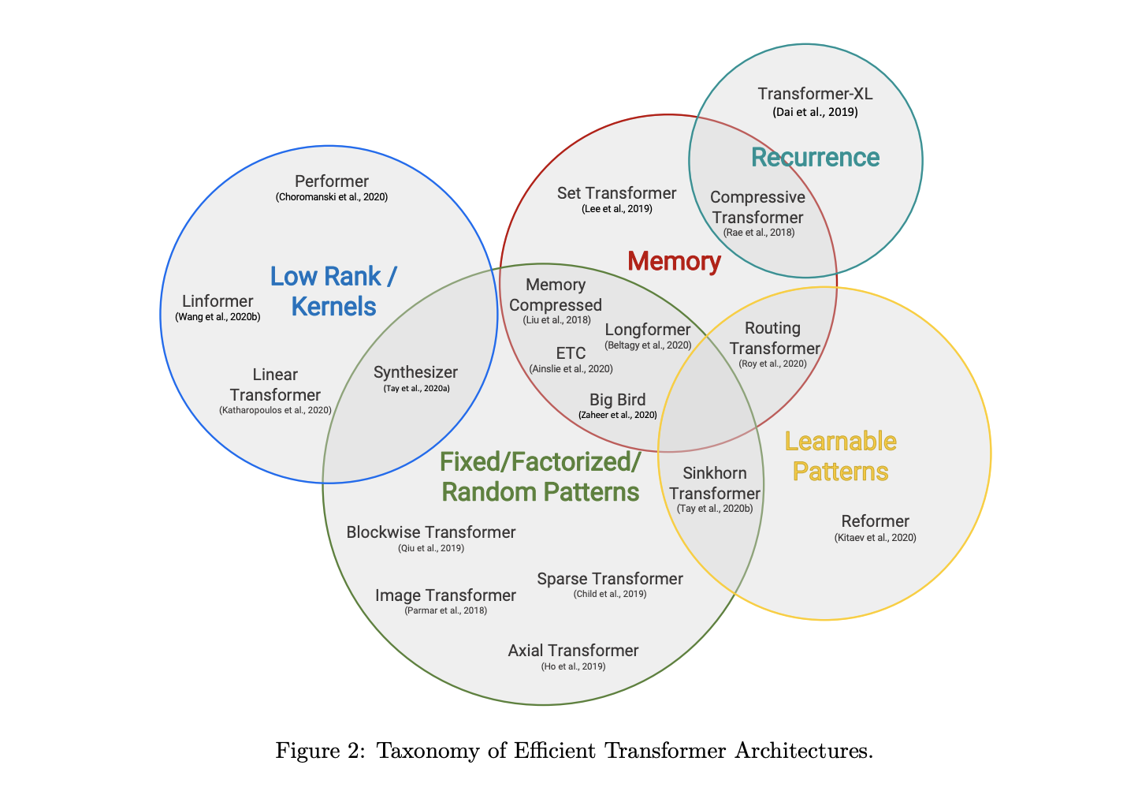
Fixed Patterns (FP) - The earliest modifications to self-attention simply sparsifies the attention matrix by limiting the field of view to fixed, predefined patterns such as local windows and block patterns of fixed strides.(AN IMAGE IS WORTH 16X16 WORDS)
Learnable Patterns (LP) - The key idea of learnable patterns is still to exploit fixed patterns (chunked patterns). However, this class of methods learn to sort/cluster the input tokens - enabling a more optimal global view of the sequence while maintaining the efficiency benefits of fixed patterns approaches.
Memory - Another prominent method is to leverage a side memory module that can access multiple tokens at once. A common form is global memory which is able to access the entire sequence. The global tokens act as a form of memory that learns to gather from input sequence tokens.
Low-Rank Methods - Another emerging technique is to improve efficiency by leveraging low-rank approximations of the self-attention matrix. The key idea is to assume low-rank structure in the N × N matrix.
Recurrence - A natural extension to the blockwise method is to connect these blocks via recurrence. Transformer-XL (Dai et al., 2019) proposed a segment-level recurrence mechanism that connects multiple segments and blocks. These models can, in some sense, be viewed as fixed pattern models.

Slide 4
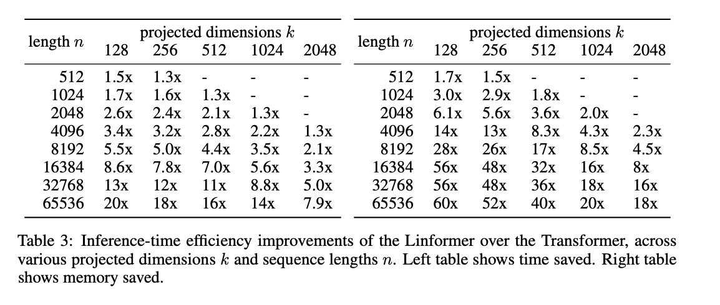
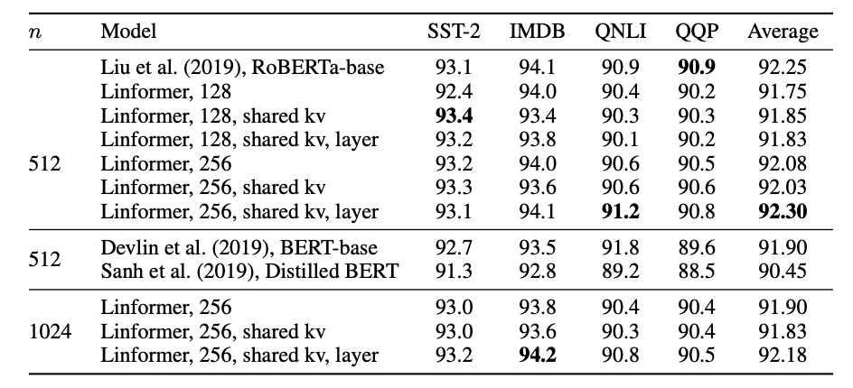
Motivation: This paper suggests an approximate way of calculating self-attention in Transformer architectures that has linear space and time complexity in terms of the sequence length, with the resulting performance on benchmark datasets similar to that of the RoBERTa model based on the original Transformers with much less efficient quadratic attention complexity
Method: They show both theoretically and empirically that the attention dot product matrix can always be closely approximated by a matrix of much lower rank, which can be obtained by calculating the singular value decomposition (SVD) of the key and value matrices and only using a fixed number of the largest singular values. Since SVD calculation also adds computational complexity, the authors replace it with a linear projection layer that serves to reduce the dimensionality. For simplicity, the trainable projection layer parameters can be shared between attention heads and/or between layers.
Results:

Slide 5
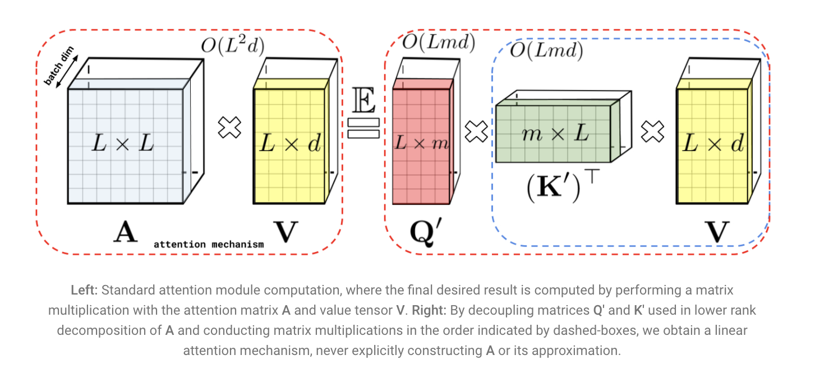
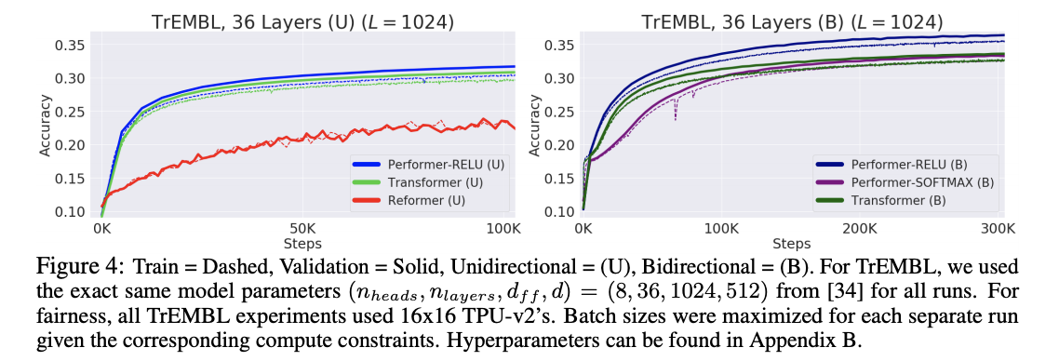
Motivation: To address the complexity challenge of Transformers, They present a new Transformer architecture, Performer, based on Fast Attention Via Orthogonal Random features (FAVOR). Their mechanism scales linearly rather than quadratically in the number of tokens in the sequence, is characterized by sub-quadratic space complexity and does not incorporate any sparsity pattern priors. Furthermore, it provides strong theoretical guarantees: unbiased estimation of the attention matrix and uniform convergence. It is also backwards-compatible with pre-trained regular Transformers.
Method:
Results:

Slide 6
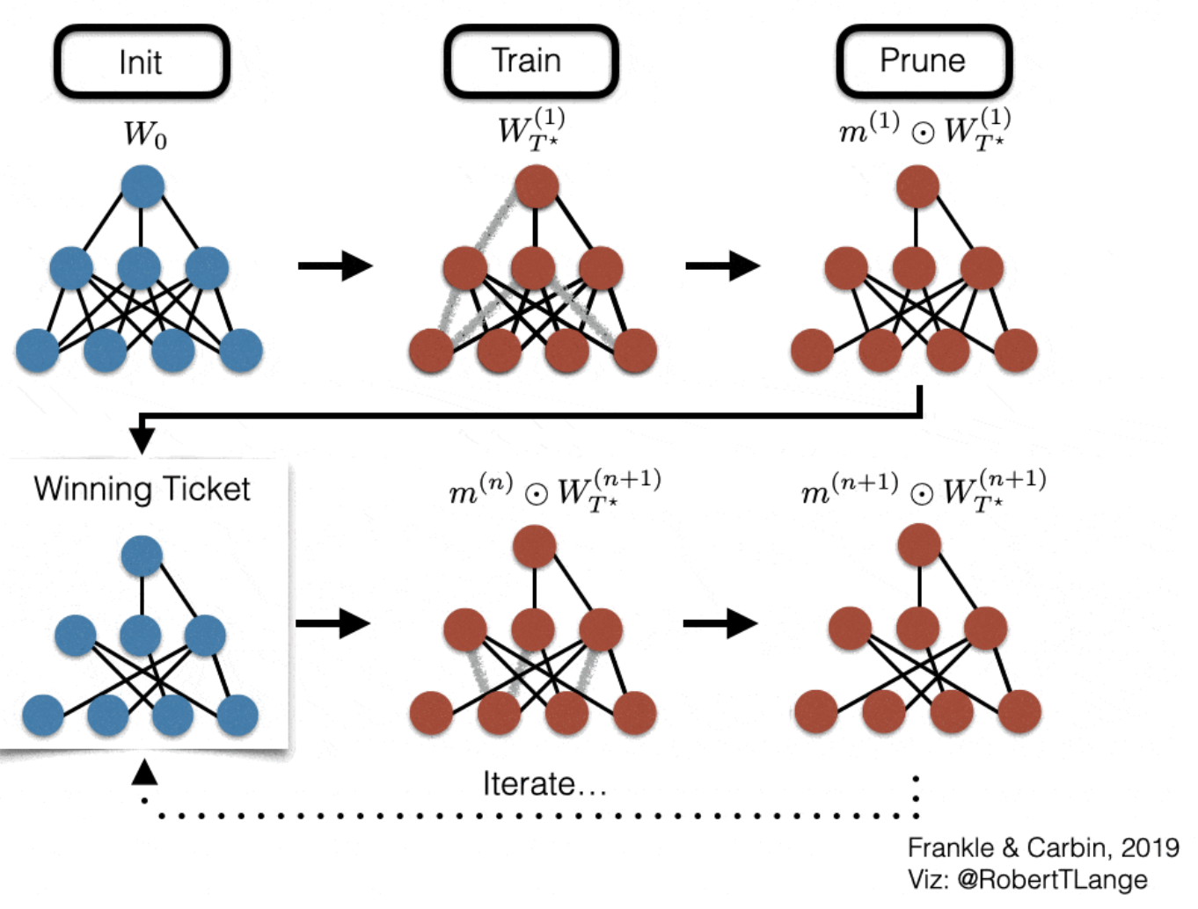
Motivation: In this tinyML presentation they want to draw lottery tickets ( sub-networks) from large pre-trained models.They are interested in finding lottery tickets in pre-training because it provides appealing avenue to get rid of the actual “rewinding” step of LTH. Regarding practicality, LTH could compress large pre-trained network to be deployed on mobile devices. LTH also shows promise in being transferable to different domains and their tasks. Thus a mask of a large pre-trained can be re-used infinitely many times. Making LTH initial resource cost manageable.
Method: unstructured iterative magnitude pruning on large pre-trained networks.
Results:
They find matching subnetworks at between 40% and 90% sparsity in BERT models on standard GLUE and SQuAD downstream tasks.
Subnetworks at 70% sparsity found using the masked language modeling task (the task used for BERT pre-training) are universal and transfer to other tasks while maintaining accuracy.
They identify matching sub-networks up to 67.23%, 59.04%, 95.60% sparsity, at pre-trained weights from ImageNet-equipped supervised pre-training, simCLR and MoCo, respectively.
Subnetworks at 67.23%, 59.04% and 59.04% sparsity, found respectively using supervised ImageNet, simCLR and MoCo pre-training, are universally transferable to diverse downstream classification tasks with nearly the same accuracies
https://www.youtube.com/watch?v=40B-8SLfLUQ

